Slide 1
Final Presentation: U.S. Wildfire Prediction
Instructor: James Topor
Group Member: Kunming Song, Mhariadora Bocalbos, Renzhu Li

Slide 2
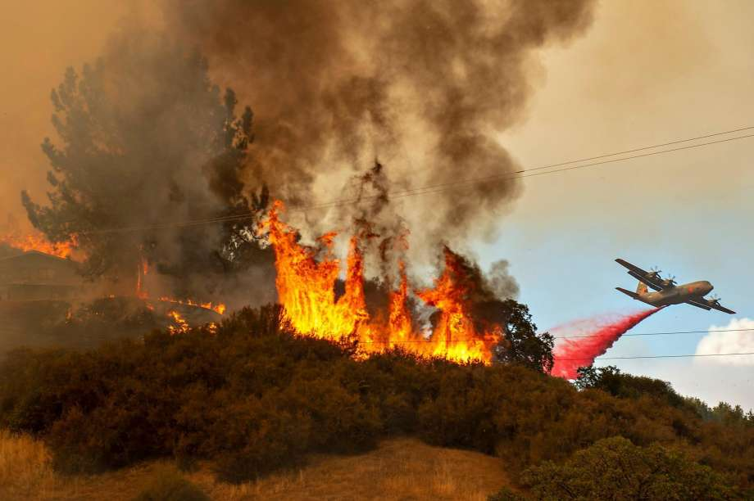
Data Resources
Exploratory Data Analysis
Conclusion and Analyzation

Slide 3
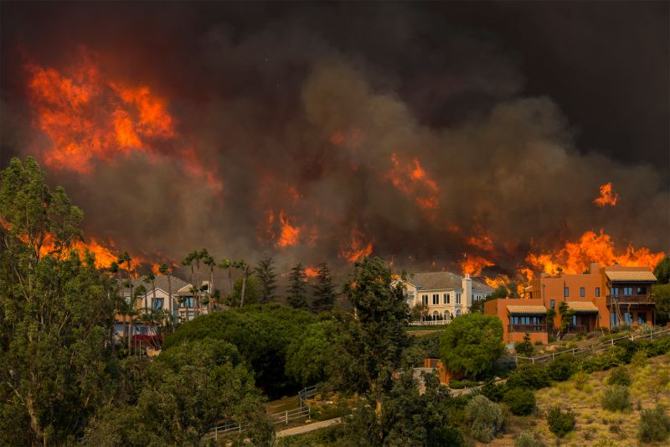
Challenges
Various Datasets
Extract Tables from PDF file and Import to Python

Slide 4
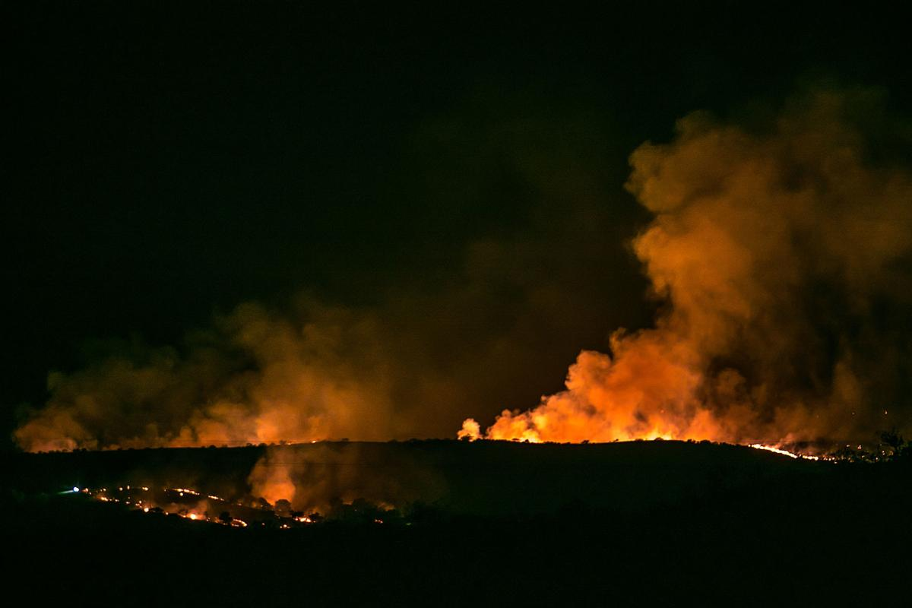
Camelot Library
Prerequisites for running the code:
Install Camelot Library
CV2 Library
Ghostscript
Sample code:
import os
import camelot
import cv2
path = r'C:\Maridor\MS DAV\DAV 5400 - Analytics Programming\Final Project\fire'
for myfiles in os.listdir(path): #loops through the folder above to check for the PDF files
if myfiles.endswith('.pdf'): #searches for only PDF file
fname, fext = os.path.splitext(myfiles) #splits the filename and extension
tables = camelot.read_pdf(path + '\\' + myfiles, pages='1,2,3,10,11,12') #looks for the pages where the target table is and reads it
tables.export(r'C:\Maridor\MS DAV\DAV 5400 - Analytics Programming\Final Project\fire\text files' + '\\' + fname + '.csv', f='csv') #extracts and exports the file as a CSV file

Slide 5
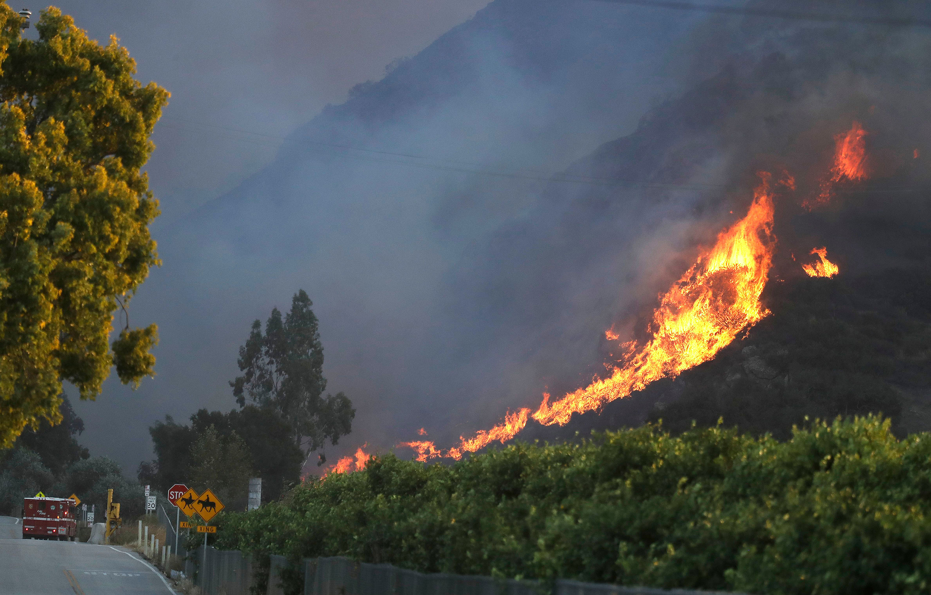
The result from our final project and prediction for the future wildfire:
Since we couldn't predict the fire trend based on our analysis, but we did get the insights about which season had the highest fires (summer), so our recommendation is to add more fire protection during summer such as hire more employees during summer season.
After analyzing the size of fires, we concluded spring season has highest fire size, so we recommend to allocate most easy fire area based on another history fire map analysis to separate these area by building some fire protection wall.
After analyzing the California fire data, we recommend to apply the same concept to other states to figure out which season has the highest fire.

Slide 6
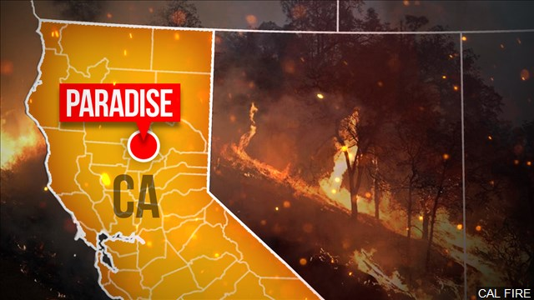
Thank You!

